Slide 1
Digital Filtering
Numerical integration
  Forward rectangular rule
  Backward rectangular rule
  Trapezoid (or bilinear) rule
  Bilinear rule with pre-warping

Slide 2
Digital Filtering
One method of digital control design is called Emulation
  Design a continuous compensator first, and then map that to a digital controller that emulates the continuous one.
    A continuous compensator D(s) is essentially a filter.
    Goal is to determine a discrete controller D(z) that approximates the behavior of D(s).
Methods of approximating a continuous transfer function H(s) with a discrete one H(z):
  Numerical integration
  Pole-zero mapping
  Hold equivalents

Slide 3
Numerical Integration
How do we numerically integrate a continuous function accurately?
Numerically, only feasible to evaluate e(t) at a finite number of points (that may be evenly or unevenly spaced).
Assuming we have evenly spaced samples of e(t):

Slide 4
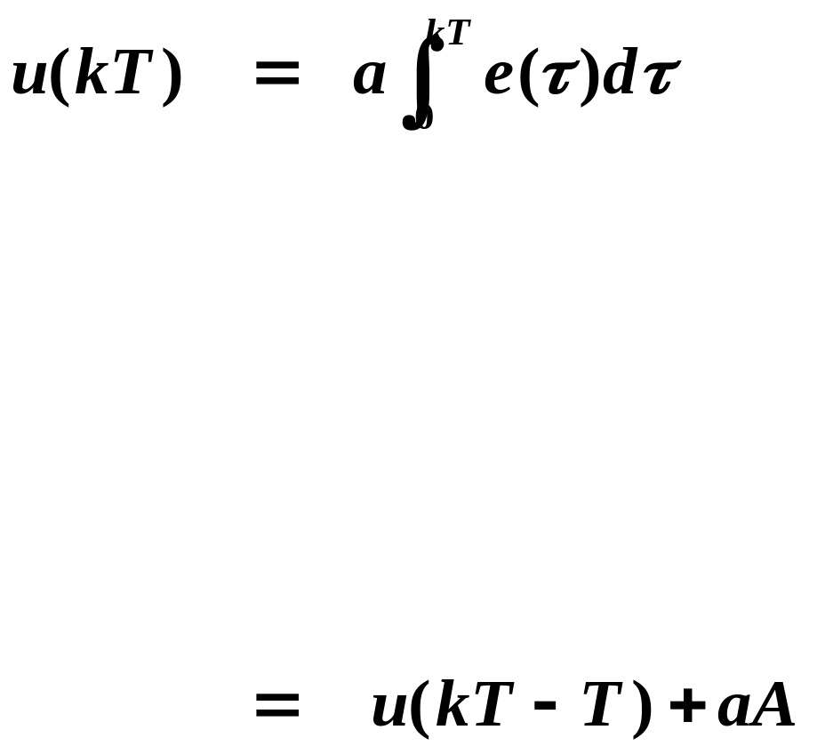
How do we approximate A ?
  Forward rectangular rule (Euler’s rule)
  Backward rectangular rule
  Trapezoid rule (Tustin’s rule) (bilinear transform)

Slide 5
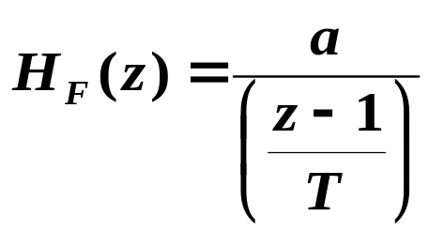
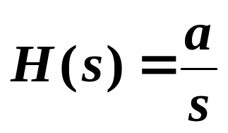
Forward Rectangular Rule
Approximate A by looking “forward” from kT - T.
vs.

Slide 6
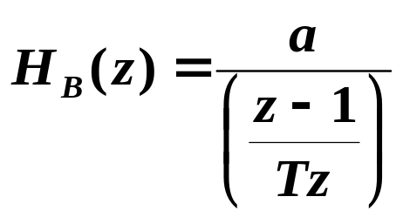
Backward Rectangular Rule
Approximate A by looking “backward” from kT.
vs.

Slide 7
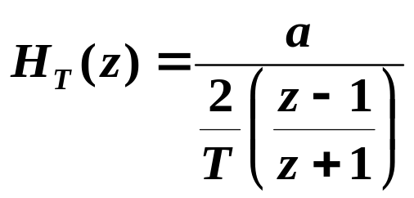
Trapezoid Rule
Approximate A by the area of the trapezoid formed by e(kT - T) and e(kT).
vs.

Slide 8


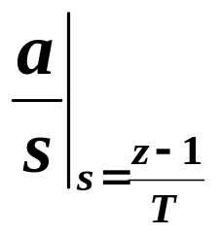
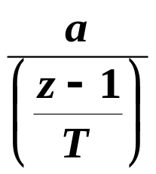
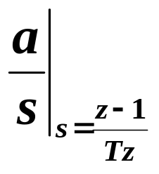
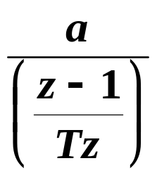
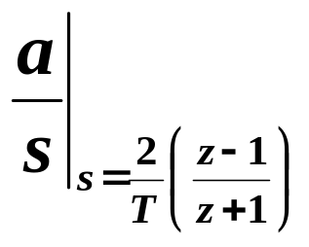
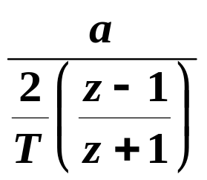
Summary of Numerical Integration
Im(z)
Forward
rule
Re(z)
Im(s)
1
Im(z)
Re(s)
Backward
rule
Re(z)
1
Im(z)
Trapezoid
rule
Re(z)
1

Slide 9
If we derive H(z) similarly for other (more complex) H(s), we will see that for each rule, we can substitute the same expressions above for s to get H(z).
Note that we do not need to know the poles and zeros of H(s) to find H(z).
These substitutions for s allow us to map an H(s) to an H(z). Note that all the substitution expressions depend on T.
If H(s) is stable (poles in LHP of s–plane), is H(z) stable (poles inside UC of z–plane) under these maps?

Slide 10
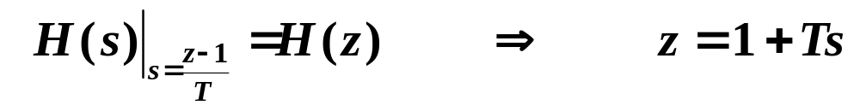
Forward Rectangular Rule
If H(s) has a pole at s_{p} , then H(z) has a pole at z_{p} = 1 + T s_{p} .
Im(s)
Im(z)
1
Re(s)
Re(z)
-1
1
-1
If H(s) is stable, H(z) is not guaranteed to be stable!

Slide 11
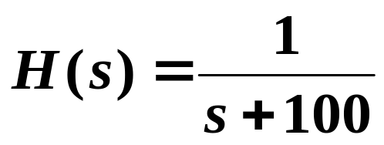

Example

Slide 12
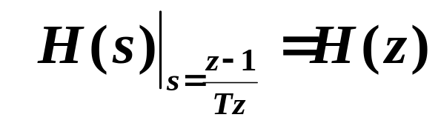
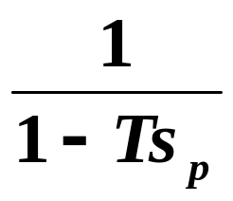
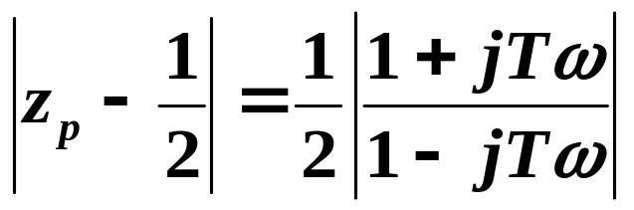
Backward Rectangular Rule
If H(s) has a pole at s_{p} , then H(z) has a pole at z_{p} =
If s_{p}= jω (on stability boundary), then

Slide 13
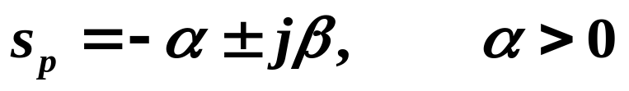
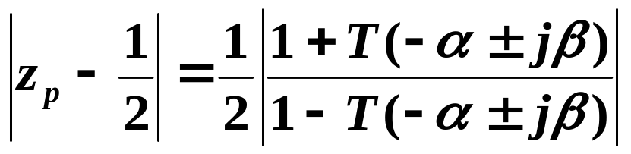
If s_{p} is in the LHP, say
then
Im(s)
Im(z)
1
Re(s)
Re(z)
-1
1
-1
If H(s) is stable, H(z) is guaranteed to be stable.

Slide 14
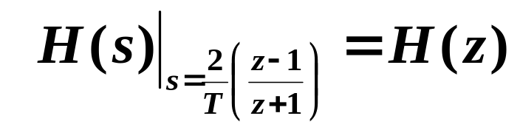
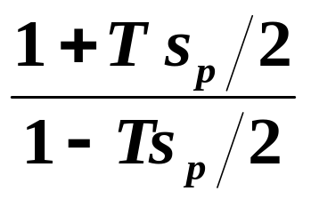
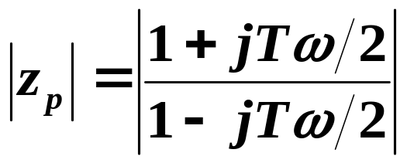
Trapezoid or Bilinear Rule
If H(s) has a pole at s_{p} , then H(z) has a pole at z_{p} =
If s_{p}= jω (on stability boundary), then

Slide 15
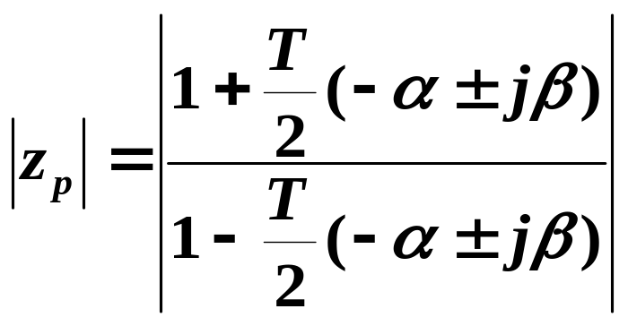
If s_{p} is in the LHP, say
then
Im(s)
Im(z)
1
Re(s)
Re(z)
-1
1
-1
If H(s) is stable, H(z) is guaranteed to be stable.

Slide 16


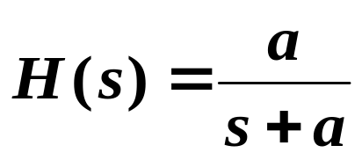
Stability region maps exactly from s-plane to z-plane, but behavior and characteristics of H(z) are usually still different from those of H(s).
For example, apply a sinusoid of frequency ω₁ to both H(s) and H(z), will the output signal have the same magnitude?
Consider

Slide 17
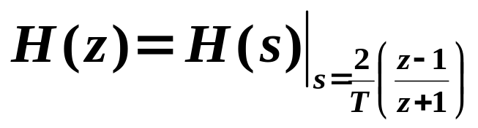
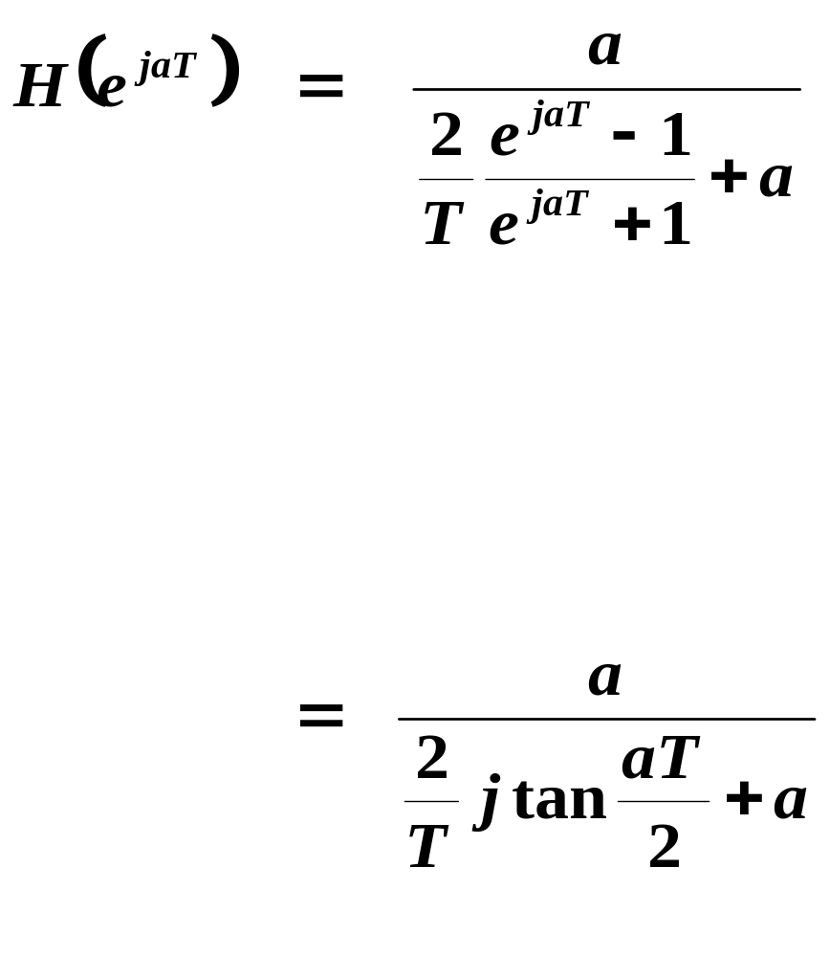

Slide 18
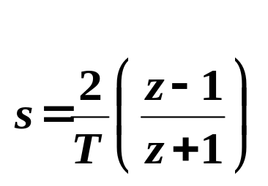
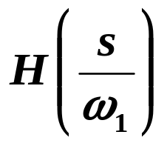
Bilinear Rule with Pre-Warping
“Pre-warp” H(s) before applying
so that final H(z) has same half power point as original H(s).
Re-write H(s) in the form where ω₁ is the critical frequency where we want |H(z)| to match |H(s)|.

Slide 19
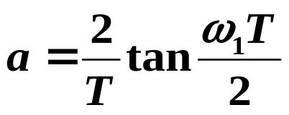
Replace ω₁ by a where
Map to H_{p}(z) using

Slide 20
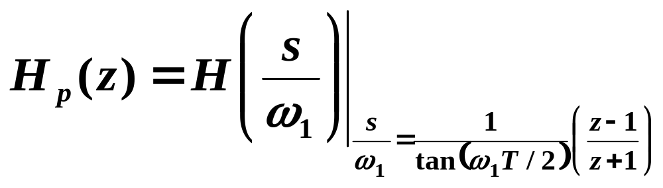
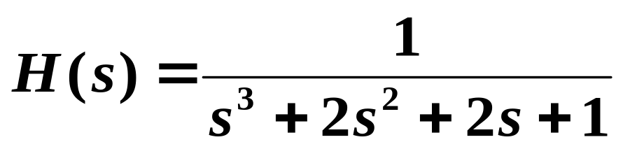
Overall frequency substitution rule is
Consider Example 6.1 of text:
Im(s)
Re(s)
3rd-order Butterworth filter with unity bandwidth ω_{p}=1.
Find H(z) to match H(s) at ω_{p}=1. See Figure 6.4 of text.

